Slide 1
Chapter 55.1 & 2
Ecosystems
and
Restoration
Ecology

Slide 2
55.1 Physical laws govern energy flow
and chemical cycling in ecosystems
55.2 Energy and other limiting factors
control primary production in
ecosystems

Slide 3

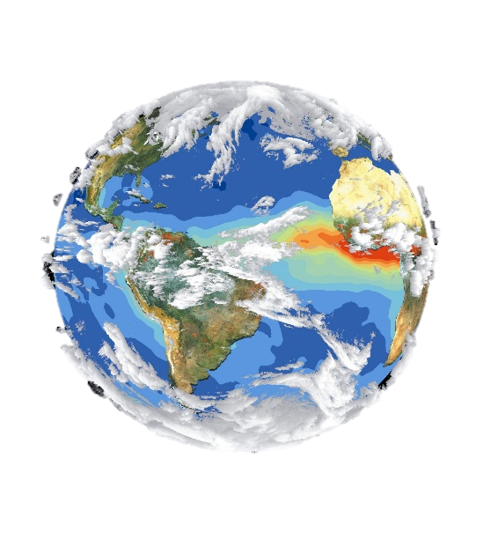
Overview
Ecosystem: the sum of all the organisms
in a community and their response to the abiotic factors and flow of energy in their environment.

Slide 4

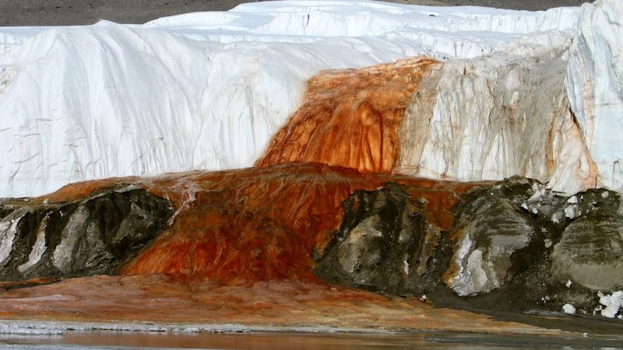
Overview
An ecosystem can be formed by unusual community of organisms, like the chemoautotrophic bacteria living below Taylor Glacier in Antarctica.
In the freezing deep water below earth’s surface, where
is no light or oxygen, the chemoautotrophic bacteria
obtains energy through chemosynthesis. During the chemosynthesis process, the bacteria oxidizes the sulfur found in their habitat and uses iron as the final electron acceptor (oxidizing agent). As water flows out from the glacier’s base to the surface and interacts with O2 in the air, the reduced
iron in the water becomes oxidized and turns red before the water freezes, forming what is known as Blood Fall.

Slide 5
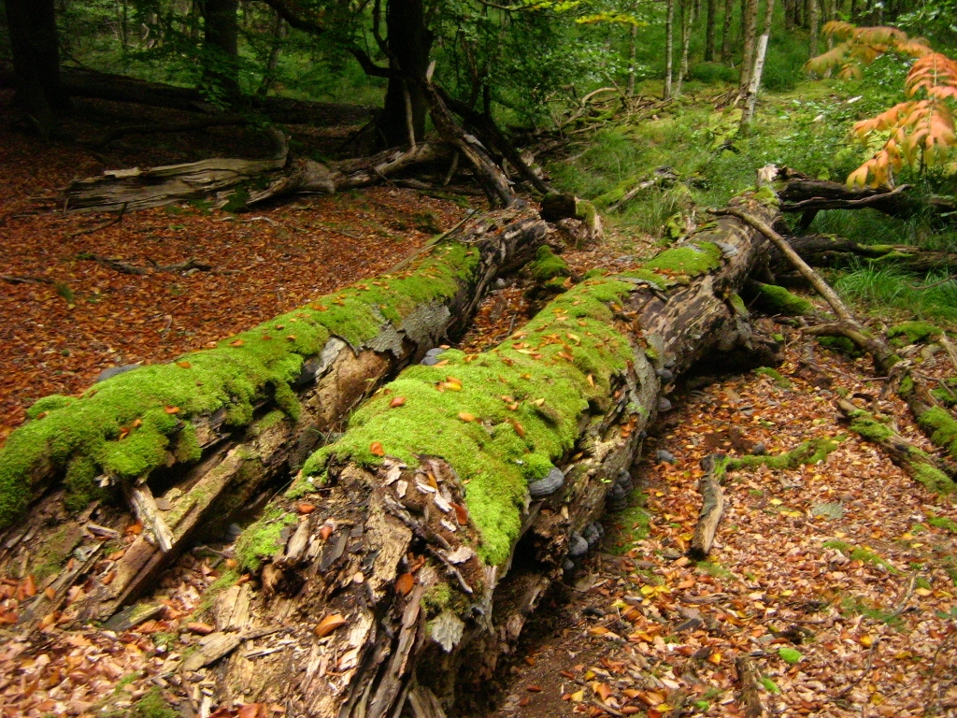
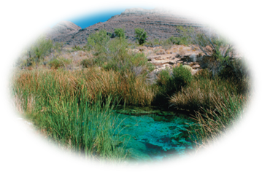
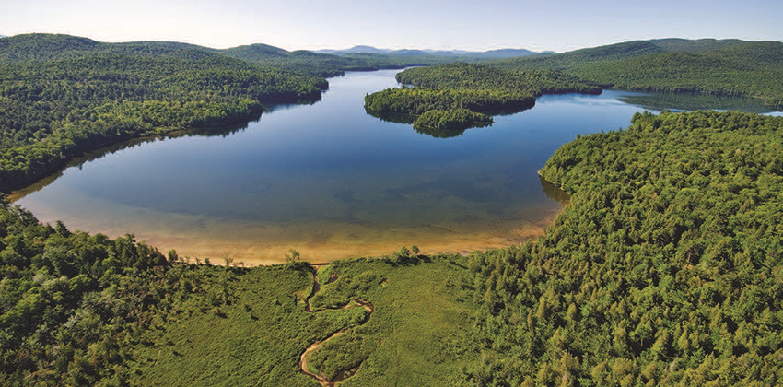
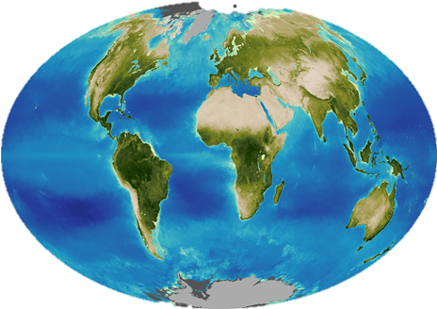
Overview
An ecosystem can be microcosmic such as a small area under a log, rock, or in a pond.
A vast area like a lake or forest.
The entire biosphere is regarded as a global
ecosystem encompassing all the local
ecosystems on Earth.
Regardless of its size, the dynamics and survival of an ecosystem are determined by two processes: energy flow and chemical cycling.
Energy flows through ecosystems while matter cycles within them.

Slide 6
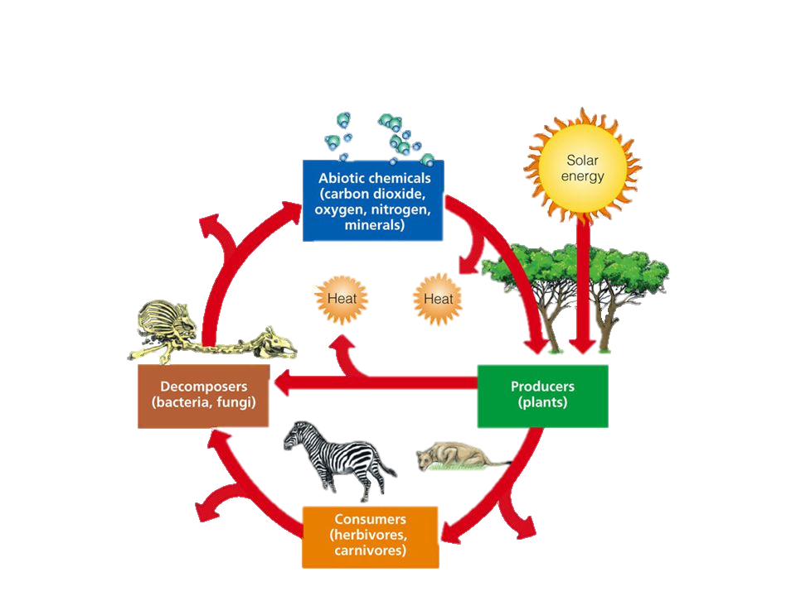



55.1 Physical laws govern energy flow and
chemical cycling in ecosystems
Ecologists study the transformations of energy and matter within an ecosystem system.
Solar Energy
Heat
Heat
Heat
Heat
Heat

Slide 7
55.1
Conservation of Energy
Laws of physics and chemistry apply to ecosystems, particularly energy flow.
The first law of thermodynamics: energy cannot be created or destroyed, only transformed.
Energy enters an ecosystem as solar radiation, is conserved, and is lost from organisms as heat.

Slide 8
55.1
Conservation of Energy
The second law of thermodynamics: every exchange of energy increases the entropy of the universe.
In an ecosystem, energy conversions are not completely efficient, and some energy is always lost as heat.

Slide 9
55.1
Conservation of Mass
The law of conservation of mass: matter cannot be created or destroyed.
Chemical elements are continually recycled within ecosystems.
In a forest ecosystem, most nutrients enter as dust or solutes in rain and are carried away in water.
Ecosystems are open systems, absorbing energy and mass and releasing heat and waste products.

Slide 10
55.1
Energy, Mass, and Trophic Levels of Mass
Autotrophs build molecules themselves using photosynthesis or chemosynthesis as an energy source.
Heterotrophs depend on the biosynthetic output of other organisms.
Energy and nutrients pass from primary producers (autotrophs) to primary consumers (herbivores) to secondary consumers (carnivores) to tertiary consumers (carnivores that feed on other carnivores).

Slide 11
55.1
Detritivores, or decomposers, are consumers that derive their energy from detritus (nonliving organic matter).
Decomposers convert organic matter to inorganic compounds used by primary producers to complete the chemical cycle. The decomposition connects all trophic levels.
Prokaryotes and fungi are essential detritivores in an ecosystem.

Slide 12
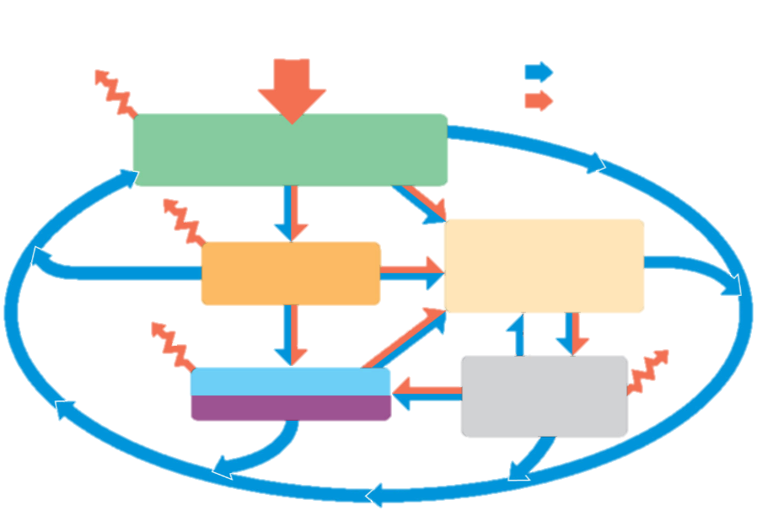
55.1
Sun
Key
Chemical cycling
Energy flow
Heat
Primary producers
Primary
consumers
Detritus
Secondary and
tertiary consumers
Microorganisms
and other
detritivores

Slide 13
55.2 Energy and other limiting factors control primary
production in ecosystems
In most ecosystems, primary production is the amount of light energy converted to chemical energy by autotrophs during a given time period.
In a few ecosystems, chemoautotrophs are the primary producers.
The initial energy input is chemical and the initial products are the organic compounds synthesized
by the microorganisms.

Slide 14
55.2
Ecosystem Energy Budgets
The primary, secondary, and tertiary consumers receive their energy from the production of the primary producers. Therefore, the amount of photosynthetic production establishes the limit (budget) of energy that the ecosystem can use.

Slide 15
55.2
The Global Energy Budget
The amount of solar radiation reaching the Earth’s surface limits photosynthetic output of ecosystems.
Only a small fraction of solar energy actually strikes photosynthetic organisms, and even a smaller fraction is of a usable wavelength.

Slide 16
55.2
Gross and Net Production
Gross primary production (GPP) is the total amount of primary production (photosynthesis or light energy converted to chemical energy) of organic molecules per unit time.
Some of the production is used for cellular respiration.

Slide 17
55.2
Net primary production (NPP)
Net primary production (NPP) is GPP minus energy used by primary producers for respiration. NPP = GPP – Ra (autotrophic respiration)
NPP is calculated as:
2
Energy per unit area per unit time (J/m yr)
.
Or
2
.
Biomass added per unit area per unit time (g/m yr)

Slide 18
55.2
Net primary production (NPP)
NPP is the amount of new biomass added in a given time period.
Standing crop is the total biomass of photosynthetic autotrophs at a given time.
Ecosystems vary greatly in NPP and their contribution to the total NPP on Earth.

Slide 19
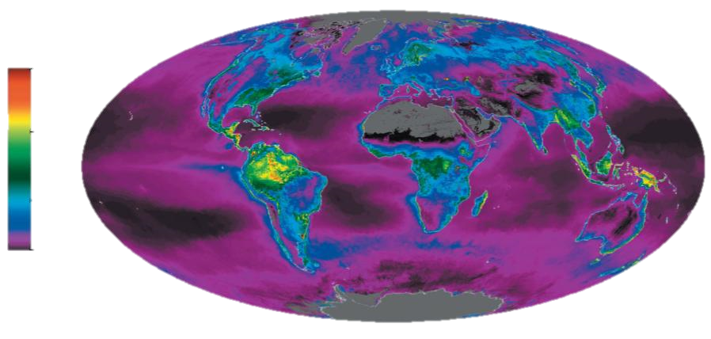
55.2
Net primary production
(kg carbon/m² yr)
.
3
2
1
0

Slide 20
55.2
Net ecosystem production (NEP)
Net ecosystem production (NEP) is a measure of the total biomass accumulation during a given period.
NEP is gross primary production (GPP) minus the total respiration of all organisms (producers and consumers) in an ecosystem.
NEP is estimated by comparing the net flux (flow) of CO2 and O2 in an ecosystem, two molecules connected by photosynthesis.
The release of O2 by a system is an indication that it is also storing CO2.

Slide 21
55.2
Primary Production in Aquatic Ecosystems
In marine and freshwater ecosystems, both light and nutrients control primary production.

Slide 22
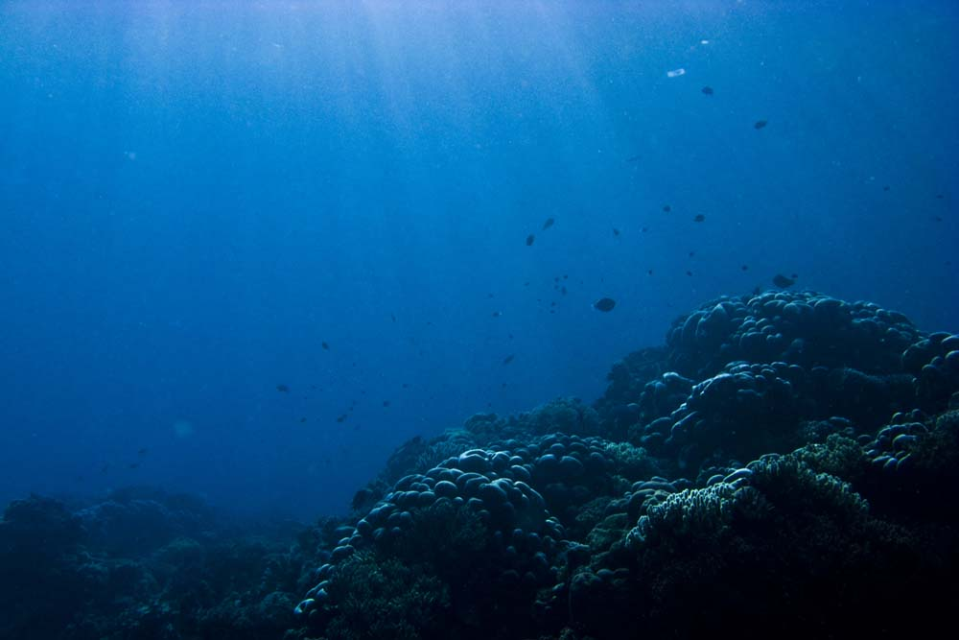
55.2
Light Limitation
Depth of light penetration affects primary production in the photic zone of an ocean or lake.

Slide 23
55.2
Nutrient Limitation
More than light, nutrients limit primary production in geographic regions of the ocean and in lakes.
A limiting nutrient is an element that must be added for production to increase in an area. Nitrogen and phosphorous are the typical limiting nutrients.
Experiments in the Sargasso Sea showed that iron limited primary production.
Upwelling (surge) of nutrient-rich waters in parts of the oceans contributes to regions of high primary production. However, the addition of large amounts of nutrients to lakes has a wide range of ecological impacts.

Slide 24
55.2
In some areas, sewage runoff has caused eutrophication of lakes, which can lead to loss of most fish species.
Eutrophication is an ecological process by which the concentration of oxygen and clarity of water are reduced due to the rapid growth of Cyanobacteria and algae in response to added nutrients in runoff water.
In lakes, phosphorus limits cyanobacterial growth more often than nitrogen. This has led to the use of phosphate-free detergents

Slide 25
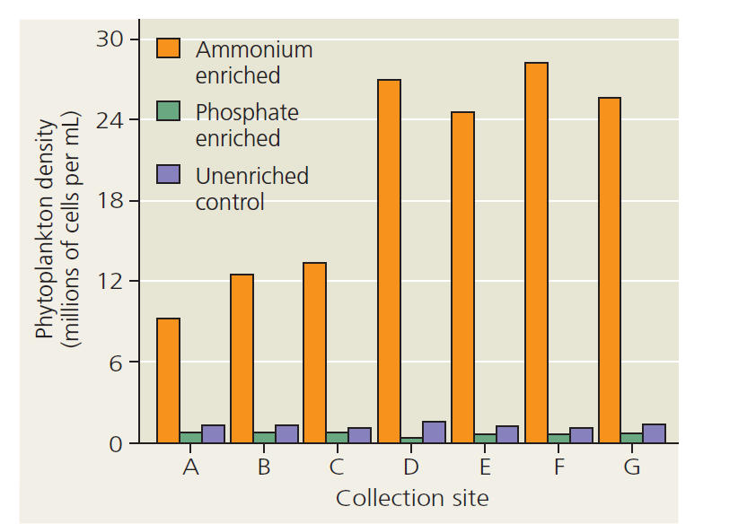

Slide 26
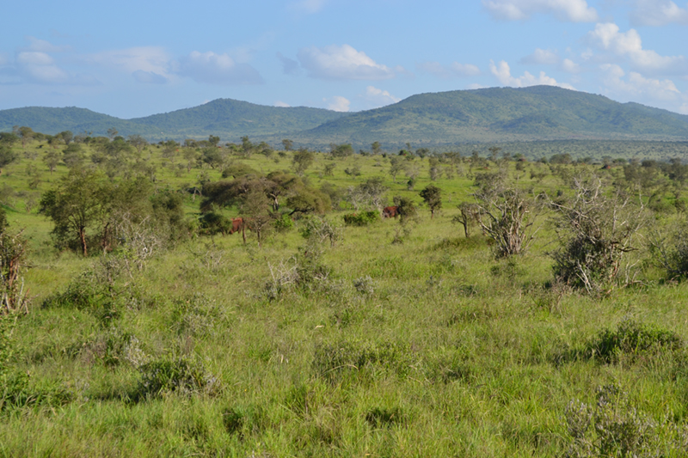
55.2
Primary Production in Terrestrial Ecosystems
In terrestrial ecosystems, temperature and moisture affect primary production on a large scale.
Primary production increases with moisture.
Actual evapotranspiration is the water transpired by plants and evaporated from a landscape. It is affected by precipitation, temperature, and solar energy.
It is related to net primary production.

Slide 27
55.2
Nutrient Limitations and
Adaptations That Reduce Them
On a more local scale, a soil nutrient is often the limiting factor in primary production.
In terrestrial ecosystems, nitrogen is the most common limiting nutrient.
Phosphorus can also be a limiting nutrient, especially in older soils.

Slide 28
Various adaptations help plants access limiting nutrients from soil.
Some plants form mutualisms with nitrogen-fixing bacteria.
Many plants form mutualisms with mycorrhizal fungi; these fungi supply plants with phosphorus and other limiting elements.
Roots have root hairs to increase surface area.
Many plants release enzymes that increase the availability of limiting nutrients.

